Slide 1
Distribution Tutorial
Learn Basic principles in Gizmo Distribution
Build distributed SW
C# interfaces
Tools
Anders Modén Saab AB, Training & Simulation
This document and the information contained herein is the property of Saab AB and must not be used, disclosed or altered without Saab AB prior written consent.

Slide 2
Saab Distribution C# library
GitHub Repo
Download or fork from…
https://github.com/ToolTech/Distributed_Domain_Demo

Slide 3
Saab Distribution C# library
A platform independent C++/C# library for distributed objects and events
High performance data throughput
Easy to use API
Subscription model
Ownership model
Management model
Runtime license for commercial use

Slide 4
Session
A session represents an interest in a topic
Just like a conference room where you meet and discuss a topic
Any number of sessions
A session can be local or global
You can join and resign interest in a session topic

Slide 5
Manager
You need a manager to start working with distribution
A manager will provide you resources
Can be many managers but you typically work with the default manager
A manager is like the booking system for conference rooms

Slide 6
Client
You identify yourself as a client when working with distribution
You identify a client with a name
Convenient to interact with system through your client
When client goes out of scope, the sw shuts down
A client gets information from manager and other components via delegate notifications
A client has an async handling of notifications
A client is like you in a conference room

Slide 7
Local Session
A local session is a topic just in your process
Only clients in your process (your code) can access this topic
There can be many processes on the same machine that has the same topic but they are not visible to each other
Local sessions are very fast as they don’t communicate outside process

Slide 8
Global Session
A global session is a topic that can extend beyond your process
A global session is visible in a tcp/udp network (or using other transport protocols)
The network used can be a network between processes on many computers or a network between processes on your machine only
A global process has a unique name between processes

Slide 9
Events
An event is a temporal occurrence
It can contain attributes and values
It can be of a certain type
Once sent it is no longer valid
Once received you can only look at it
An event is sent/received on a session
Only subscribed event types are received

Slide 10
Objects
An object is a durable instance
It can contain attributes and values
It can be of a certain type
An object has a life span from creation until destruction
Only subscribed object types are notified

Slide 11
Attributes
An attribute is a named value
Attributes are located in objects and events
Attributes have unique names in an object instance or event instance
The value of an attribute can be any type of data that can be serialized by DynamicType (number, string, guid etc..)

Slide 12
Session events
Events are located in sessions
An event can be sent and received in a session
An event is like shouting out a message in a conference room
An event can deliver attributes that describes the event

Slide 13
Session objects
Objects are located in sessions
An object can be created and destroyed in a session
An object is like a cup of coffee standing on the table in the conference room
The object can be described by its attributes like a cup with “color”=“blue”

Slide 14
Subscriptions
Distribution uses subscriptions to define the required notifications for the client
A client can subscribe events for a certain session
A client can subscribe new and existing objects for a certain session
A client can subscribe new and existing attributes for a certain object
A client can subscribe attribute updates for a certain attribute
A client can subscribe removal of all object related information above

Slide 15
Flow – Start
Standard procedure to set up a client
Initialize platform handles all native stuff
By starting distribution you check that it runs on your system
You can check return values for SUCCESS
// Initialize platforms for various used SDKs
GizmoSDK.GizmoBase.Platform.Initialize();
GizmoSDK.GizmoDistribution.Platform.Initialize();
// Create a manager. The manager controls it all
DistManager manager = DistManager.GetManager(true);
// Start the manager with settting for transport protocols
manager.Start(DistRemoteChannel.CreateDefaultSessionChannel(), DistRemoteChannel.CreateDefaultServerChannel());
// Client set up. You are a client that sends and receives information
DistClient client = new DistClient("Our Test Client", manager);
// We need to tell the client how to initialize
client.Initialize();

Slide 16
Flow – Sessions
Setup all topics you want to work with
Global or Local sessions
// Now we can get a session. A kind of a meeting room that is used to exchange various "topics"
DistSession session = client.GetSession("MessageSession", true, true);
// Join that session
client.JoinSession(session);

Slide 17
Flow – Event Subscription
Subscribe to show interest in event type
Use delegate to listen to events
// Subscribe standard events
client.SubscribeEvents(session);
// Create a delegete
client.OnEvent += Client_OnEvent;
---------------------------------------------------
private static void Client_OnEvent(DistClient sender, DistEvent e)
{
// Check if message is from us
if (e.GetSource() == sender.GetClientID().InstanceID)
return;
System.Console.WriteLine(e.ToString());
}

Slide 18
Flow – OBJECT Subscription
Subscribe to show interest in object type
Lots of freedom to configure subscriptions down to attributes
Use delegate to listen to different updates
Chain of subscriptions or just subscribe all

Slide 19
Flow – OBJECT Subscription
// Subscribe standard events
client.SubscribeObjects(session,null,true);
// Create a delegete
client.OnNewObject += Client_OnNewObject;
client.OnNewAttributes += Client_OnNewAttributes;
client.OnUpdateAttributes += Client_OnUpdateAttributes;
private static void Client_OnNewObject(DistClient sender, DistObject o, DistSession session)
{
sender.SubscribeAttributes(o, true);
}
private static void Client_OnNewAttributes(DistClient sender, DistNotificationSet notif, DistObject o, DistSession session)
{
sender.SubscribeAttributeValue(notif, o, true);
}
private static void Client_OnUpdateAttributes(DistClient sender, DistNotificationSet notif, DistObject o, DistSession session)
{
foreach(DistAttribute attr in notif)
{
System.Console.WriteLine(attr.ToString());
}
}

Slide 20
Flow – Factories
We want C# objects and events
We want hierarchy
We need factories
// get a new empty event from manager
MessageEvent e = manager.GetEvent<MessageEvent>();
[DistPropertyAutoStore] // We will reflect our dist property attributes at send event
[DistPropertyAutoRestore] // we will reflect our dist property attributes at OnEvent
class MessageEvent : DistEvent
{
// Let the constructor be private or internal so we dont expose this by mistake
protected MessageEvent(IntPtr nativeReference) : base(nativeReference)
{
}
// a factory design pattern for this class
public override Reference Create(IntPtr nativeReference)
{
return new MessageEvent(nativeReference) as Reference;
}
}

Slide 21
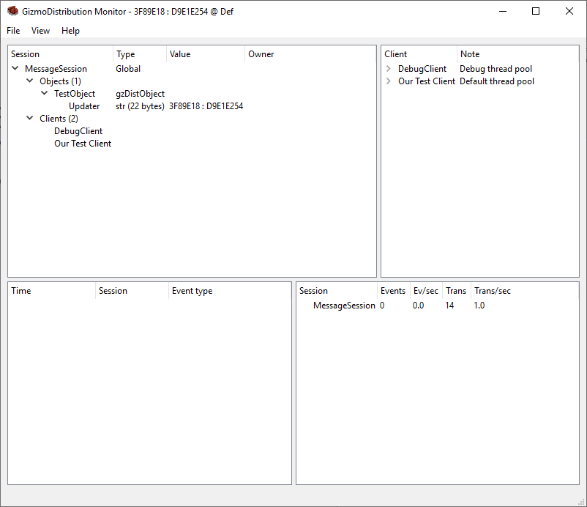
Tools - Debugging
We need a good way to debug objects and events
Inspect Subscriptions
Inspect Objects
Inspect Attributes
Follow Events

Slide 22
anders.moden@saabgroup.com

